Slide 1
Welcome

Slide 2
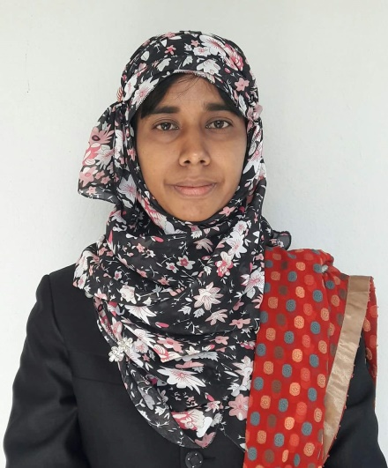
Introducing
Nasrin Akther Assistant Head Teacher Mahamuni Anglo-Pali High School.
Raozan,Chattogram
G-mail : nasrinakther984@gmail.com
Y-mail: nasrin_akther800@yahoo.com
Facebook Id : nasrin.akter.714655
Microsoft Id : akthernasrin17@outlook.com

Slide 3
Subject: English For Today
Class: seven
Unit:Three, Lesson 3.

Slide 6
Today’s Lesson
Flora’s First Day at School(2)

Slide 7
Learning Outcomes
By the end of the lesson the students will be able to…
tell the meaning of some new words
read and understand texts
talk about familiar events
write short compositions

Slide 8
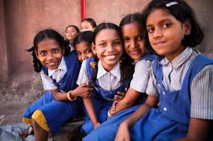
KEYWORDS
Afraid scared
Admitted repleted

Slide 9
Flora had a busy day at school
attended an interview
felt easier
a new school is a new experience
busy campus
a little afraid
got admitted to class 1
Flora

Slide 10
causes of Flora’s fear
at a different situation
over excitement
unknown people of the campus
her first day at school

Slide 11
At a stage, Flora could be easier…
Flora
The headteacher admired her talent
She could have a few friends
She was selected as a new student

Slide 12
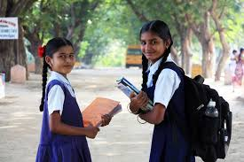

Slide 13
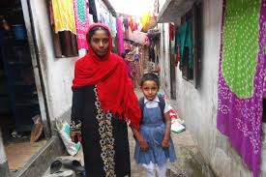
Flora is going to be a student

Slide 15
Group Work
Mention at least three reasons why Flora was afraid at school?
Flora could feel herself easier at a stage. How was it possible?

Slide 16
EVALUATION
Who took Flora to her new school?
What made Flora afraid?
Flora had to face an interview. Why?
When and why did Flora feel easier?

Slide 17
HOMEWORK
Describe briefly why Flora thought that a new school was a new experience.

Slide 18
B
Y
e
Thanks
to all of
My Dearest

